Slide 1
Discrete & Continuous Random Variables (Probability distributions, PMF, PDF, CDF, JPDF,JPMF)
Instructor
Osama Bin Ajaz
Lecturer, S & H Dept.,
FAST-NU, Main Campus, Karachi
osama.ajaz@nu.edu.pk

Slide 2
Random Variable
Two balls are drawn in succession without replacement from an urn containing 4 red balls and 3 black balls. The possible outcomes and the values y of the random variable Y , where Y is the number of red balls, are:
Suppose an experiment consists of tossing a coin two times & we are interested in the number of Heads (X):
Interest centers around the proportion of people who respond to a certain mail order solicitation. Let X be that proportion. X is a random variable that takes on all values x for which 0 ≤ x ≤ 1.
Notes:
S = { RR, RB, BR, BB} -> y = { 0, 1, 2}

Slide 3
Random Variable
Two balls are drawn in succession without replacement from an urn containing 4 red balls and 3 black balls. The possible outcomes and the values y of the random variable Y , where Y is the number of red balls, are:
Suppose an experiment consists of tossing a coin two times & we are interested in the number of Heads (X):
Interest centers around the proportion of people who respond to a certain mail order solicitation. Let X be that proportion. X is a random variable that takes on all values x for which 0 ≤ x ≤ 1.
Notes:
S = { RR, RB, BR, BB} -> y = { 0, 1, 2}

Slide 4
Discrete Probability Distribution
Tossing a coin 3 times and X = No. of heads
A shipment of 20 similar laptop computers to a retail outlet contains 3 that are defective. If a school makes a random purchase of 2 of these computers, find the probability distribution for the number of defectives.
Notes:
Tabular, formula and graphical forms. (3) X = No. of defective = {0, 1, 2}

Slide 5
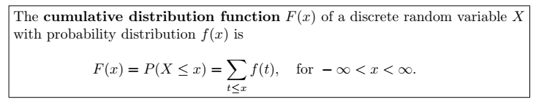
Cumulative Distribution Function
Suppose a coin is tossed 3 times and X = No. of heads.

Slide 6
Example # 01
Consider the following pmf: f(x) = (x/6), x = 1, 2, 3, zero elsewhere
Find distribution function and its graph.
Calculate P(1.5 < x ≤ 4.5)
Notes:
(i) (x<1), (1 ≤x < 2), (2 ≤ x < 3), (x ≥3)
(ii) P(1.5 < x ≤ 4.5) = 5/6

Slide 7
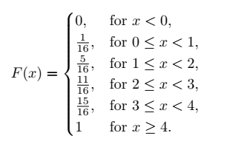
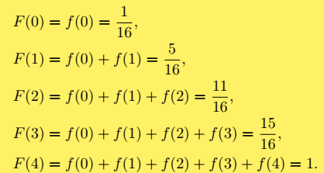
Example # 02
Find P (x = 2) = f(2)
Notes:
f(2) = 3/8

Slide 8
Example # 03 & 04
(3) Consider the following functions
(i) f(x) = (x +2) / 5 for x = 1, 2, 3, 4, 5.
(ii) f(x) = (4Cx) / (2^5), for x = 0, 1, 2, 3, and 4.
and check whether the functions can serve as a pmf ?
(4) A coin is biased so that a head occurs 3 times of tail. If the coin is tossed 3 times, find the probability distribution for the number of heads and also find P (1 ≤ x ≤ 3).
Notes:
(4) P (1 ≤ x ≤ 3). = 63/64

Slide 9
Example # 05 & 06
If two dice are rolled once, find the pmf of the sum of points on two dice and also find c. d. f (also its graph).
A fair coin is tossed until a “Head” appears for the first time. Find
(a) p. m. f
(b) distribution function
(c) F(4)
Notes:
f(z) = 1/36 … 6/36, 5/36,… 1/36
(6) F(4) = 15/16 F(5) = 31/32 F(4) = 1/32

Slide 10
Example # 07
The distribution function for a discrete random variable x is given as:
F(x) = 1 – (1/2)^(x+1), for x = 0, 1, 2, …..
Find:
P (X = 3)
P (7 ≤ x < 10)
Probability Mass Function.
Notes:
P(3) = 1/ 16
7/2^10
(c) f(x) = (1/2)^(x+1) for x = 0, 1, 2, …

Slide 11

Example # 08
Notes:
C = 1/30

Slide 12
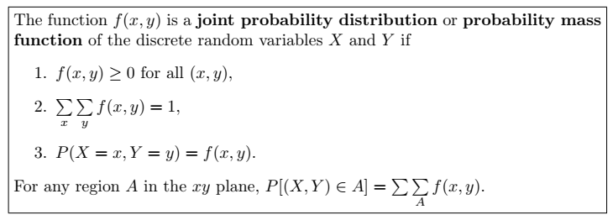
Joint Probability Distribution

Slide 13
Example # 09
Two ballpoint pens are selected at random from a box that contains 3 blue pens, 2 red pens, and 3 green pens. If X is the number of blue pens selected and Y is the number of red pens selected, find
(a) the joint probability function f(x, y)
(b) P[(X, Y ) ∈ A], where A is the region {(x, y)|y ≤ 1}

Slide 14
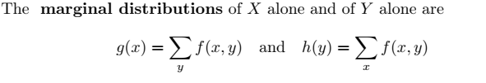

Slide 15
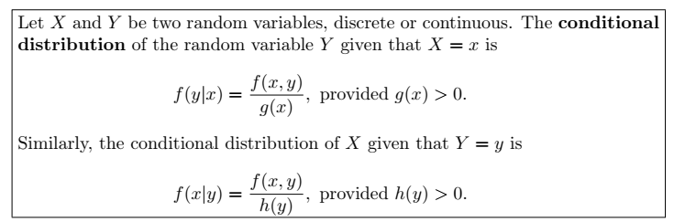

Slide 16
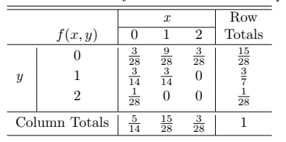
Example 09 (Contd.)
find the conditional distribution of X, given that Y = 1, and use it to determine P(X = 0 | Y = 1).
Notes:
f(0|1) = ½

Slide 17
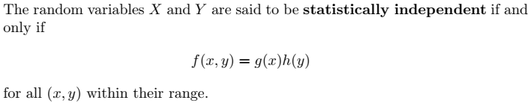
Statistical independence
Show that the random variables of Example 09 are not statistically independent for the point (0, 1).

Slide 18
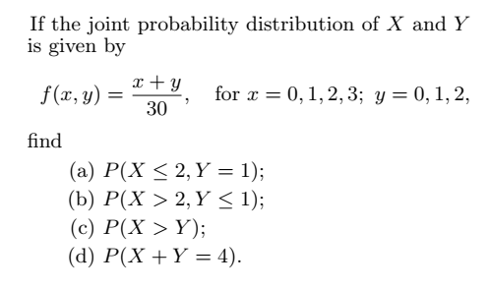
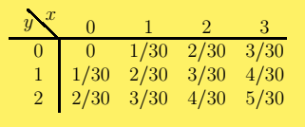
Example # 10
Notes:
(a) 1/5 (b) 7/30 (c)3/5 (d) 4/15

Slide 19
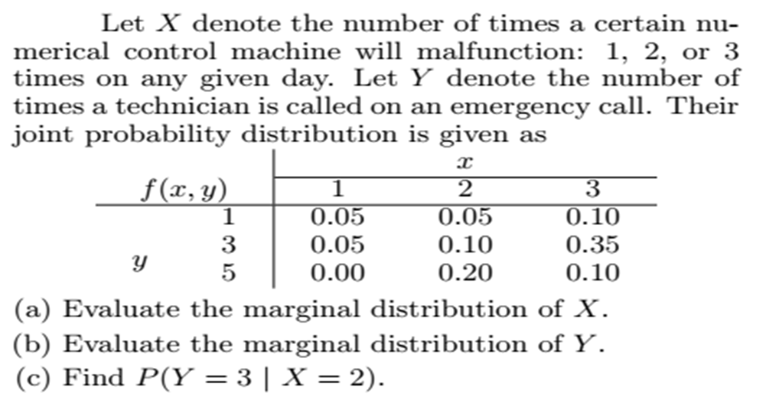
Notes:
(c) P(Y=3 given y = 2) = 0.10/0.35=0.285

Slide 20
